Slide 1
Smart Chat - Innovation Bootcamp Top 10 idea
Miguel García Sanguino
Notes:
Quien soy

Slide 2
Why we need Smart Chat?
ING is a digital platform, the ideal for our customers is to be able to carry out all the operations themselves, but when they are not able by themselves or by our platform, they call us by phone.
When a customer calls us is because it is his last resort. It is annoying for him and something expensive for us. In general, the customer calls in a more or less angry state, and also expects to be attended immediately and that his problem is solved on the spot.
Smart Chat is like WhatsApp for ING customer service, an asynchronous chat in which the customer can ask questions that are not necessarily answered immediately. Customers can therefore have several different conversations, and access the chat history. This would allow ING to answer questions between calls, or during off peak hours, and our customer is not waiting on the other side
Notes:
ING es digital
Cuando un cliente necesita ayuda llama
Esto es costoso en tiempo para clientes e ing
De ahi surge hacer un whatsapp vitaminado para atender a los clientes
------------
ING is a digital plattform, but when a client have any problem, they have to make a phone call
This consumes a lot of time to our customers and our agents
We think that making an ing vitamined whatsapp is a good idea

Slide 3
Apple and Orange have some of the best chat services we've tried, but they are far from delivering an awesome experience
Apple has a support chat.
Their agents can hardly do anything and they redirect you to the phone.
It is live, slower than a call.
If something fails, you have to start again from zero.
Orange uses whatsapp
One chat for bot and agents
Two complaints make it chaotic
If time goes by they change your agent, so you have to repeat all
The history review is complex
The agents do not have many capabilities like apple
Insecurity when giving data and documents as a third party provides a platform.
Notes:
Research de que tienen el resto (BBVA, Amazon, Apple, Orange, etc)
Cosas que no nos Gustaron:
- Agente sin capacidades - redirigen al telefono
- Apple es en directo
- No hay historico
- No paralelismo
- Tienes que repetirlo todo
- Whatsapp no da seguridad a la hora de intercambiar datos sensibles
We made a research to look what other are doing in the market
And we can detect some poitn that we dont like:
Agents dont have the power to do something and redirects customer to phone,
There is no historic, no pararell chats
Customers have to repeat whats there problem every time
Whatsapp is a third party, soy customers dont feel secure to send some documents using it

Slide 4
Younger generations prefer a chat rather than a call, which bring us multiple opportunities to improve Customer Experience
Surveys told us that customers under 30's would always choose the chat. Up to 50’s users would use chat except for emergencies. And over 70’s users would call. Every year it will go up, not only because individuals will accept it more but because in 10 years the group that always prefers the chat will be the majority, and the majority of clients that interest us will be in that range.
Main gains for the customer:
To be able to send a query at any time or place
Avoid active waiting
Reduce the total time spent
Send documentation easily and securely
Validate operations
To be able to reopen a query
Avoid having to repeat the same thing in each call
Receive interactive material
To be able to recover queries from history
Eliminate accessibility barriers
Notes:
Research
<30 a tope
>30 menos emergencias
>70 solo telefono
A dia de hoy creemos que la mayotia de clientes importantes prefieren el chat, en 10 años, mas
Clientes lo quieren para:
Cualquier moemnto y lugar
No tener espera activa y reduce tiempor total
Seguro
Historico
Reabrir incidencias
Material interactivo
under 30 whants a chat for all the communications
over 30 don like chats if they have an emergency
and over 70 only whants to call
In 10 years, all the primary custormers could like chat over phone
Any time and any moment
Dont wait actively, send and review when they get a push
Security
Can revie the History
Can Reopen issues
Can get intereactive material

Slide 5
In ING we have related initiatives, but we truly believe that Smart Chat can rule them all and go much further
In Spain we have a live chat that is like a call but by text and it's longer than a call. An asynchronous chat for only two products. And Whatsapp for Mortgages management.
Main benefits for ING:
Can be initiated by the customer or the agent.
Is private and proprietary.
Shows the history to a new agent.
Allows multiple queries at a time.
Allows to reopen chats.
Allows sending interactive material.
Automatically answer the customer.
Allows a query to go through departments: call center, quality, operations, etc.
Creates commercial offer adapted to the customer.
Notes:
Oportunidades
Aparte del chat en directo, tuexperto y whatsapp
Privado y propietario
Mostrar historico al agente, mas datos, etc
IA para ayudar al agente
Paralelismo
Catalogo de material interactivo para ayudar al agente
Integracion entre departamentos
About oportunities over the chats we have, currently in ing spain we have an online chat, tuexperto and whatsapp
Pivate and propietary
Angent can check the history, other data, etc
AI (EiAI) to show options to agent
Paralelism
Interactive Material to help the agent
Allow to go through departments

Slide 6
A squad in less than 6 months can put into production a simple asynchronous chat with queries track record
We can use this chat with iris and maggie, which will enter 4 countries in parallel and can help agents to better solve problems during the transition of each country to maggie. It will use twilio so any other country could use it.
The main source of income is cost savings:
Agents can get information without having to keep the customer waiting.
Sending documents eliminates a lot of time.
Validations without having the agent waiting.
Autoresponders in drop-offs and common issues.
Integration between departments without bureaucracy.
Catalog of answers and interactive material saves time explaining it.
Saving time by filling in the gaps
Simplifies Call Center planning
Notes:
Y ademas ahorra costes por eliminacion de tiempo
Agentes no esperan mientras valida el usuario
Envio de documentos
Autorespuestas
Rellenando los huecos y aplanando la curva de planificación
Y se puede montar sobre iris y maggie sin problema usando Twilio
Producto global escalable
Creemos que se puede hacer un MVP en poco tiempo e ir ampliando las funcionalidades
It saves costs by eliminating time, but also
the Agents do not wait while validating the user
Can Sendi documents
Autoreplies can Fill the gap and flatten the planning curve
We believe that It can be used with iris and maggie with Twilio as base that made it an Scalable global product
We estimate that a squad can make an MVP in a short time and then iterate to expand the functionalities

Slide 7
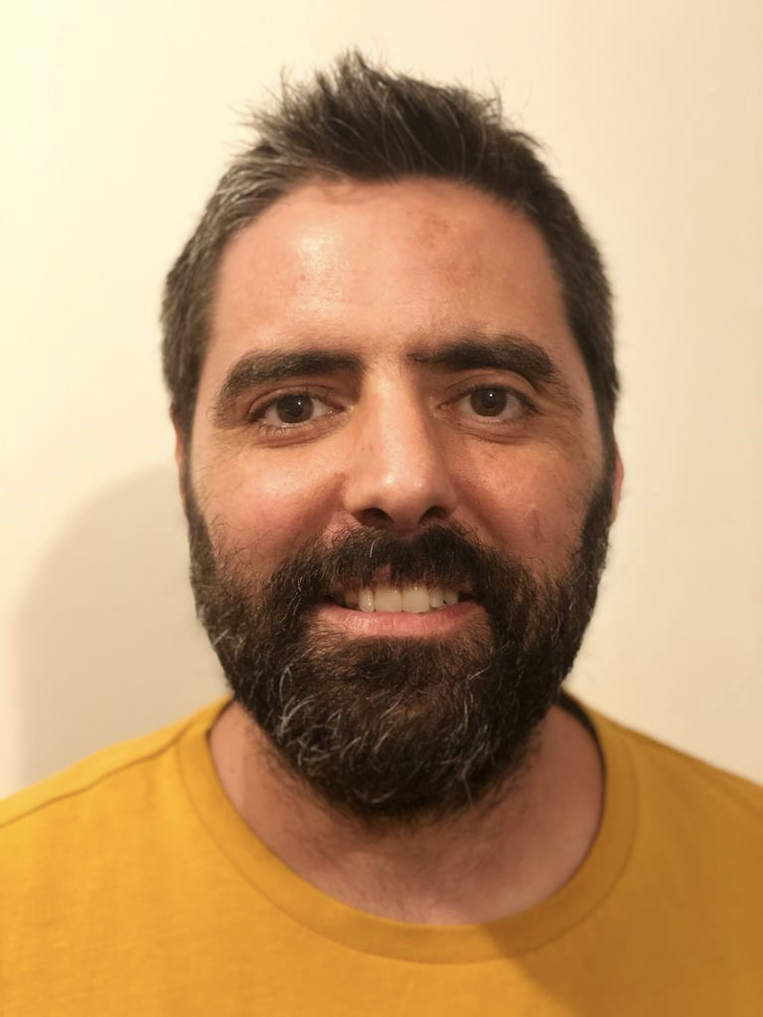





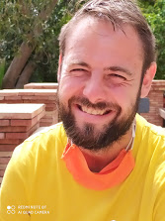

We have a multi-disciplinary team to further validate our concept in the Sprint Week with support from CoE Innovation
Miguel García Sanguino Customer B2C
Elena Fernandez Oliva Madrigal Innovation Captain
Santiago Gil Begué Customer B2B
Luis González Sotres PACE Coach
Jose Carlos Núñez Hernández Tech Ninja
Marcos Gil Fernández Tech Ninja
Jesús Espejo Arnas Tech Ninja
Carlos Collado PACE Coach
Notes:
equipo para la spring week
Datos
Seguridad
Affluent - twilio
Maggie
Innovacion
Here is the team we are going to work next week
There is experts from
Data,
Security,
Affluent,
twilio
Maggie
And ofcourse Luis and Carlos from innovation

Slide 8

Regardless the results, our innovation footprint is already here
Miguel
Methodology
Innovation process
ING knowledge
Growth
Evolution
Confidence
Notes:
la idea crecio, evoluciono y sobre todo cogio buenos cimientos
Yo he aprendido una metodologia y un proceso de innovacion que creo que puedo aplicar en otros proyectos
He conocido a mucha gente en ing a la que le he dado mucho la lata
Through the process, the idea Growth, Evolute, and a good stable base is created to evolve it more,
For me, I learn a new metodology and work in a innovation proyect than i can use in other proyects,
And of course, i have meet a lot of people form ing

Slide 9
Notes:
and thats all

Slide 10
Annex

Slide 11



We are already part of the history of Innovation Bootcamp 2020
Inspire
Refine
Sprint
Bootcamp finale
4 - 26 June
10 July – 16 September
25 September – 23 October
17 – 19 November
Inspiration sessions
Ideas submissions
Elaboration of ideas
Open sessions
Building the teams
Run an intensive Sprint
Innovation Summit
Winners selected!
Launch
Top 55
Top 10
Top 6
Winners
Ideas per challenge:
Financial Health | 126 | 12 | 2
Disrupt Lending | 92 | 12 | 3
Human Interaction | 104 | 16 | 3
Employee Experience | 118 | 15 | 2
TOTAL | 440 | 55 | 10
Top 5 countries: | Netherlands (97) Belgium (64) Spain (53) Poland (38) Germany (37) | Netherlands (17) Belgium, Germany, Turkey (5) Austria, Poland (4) Spain (3) France, Romania, Russia (2) | Netherlands (5) Germany (2) Spain, Austria, France (1)
The show must go on to the final

Slide 12

Now, we have one last candidate from Spain in this journey
Smart Chat
Human Interaction
Friendly verification
Human Interaction
SharING
Financial Health

Slide 13
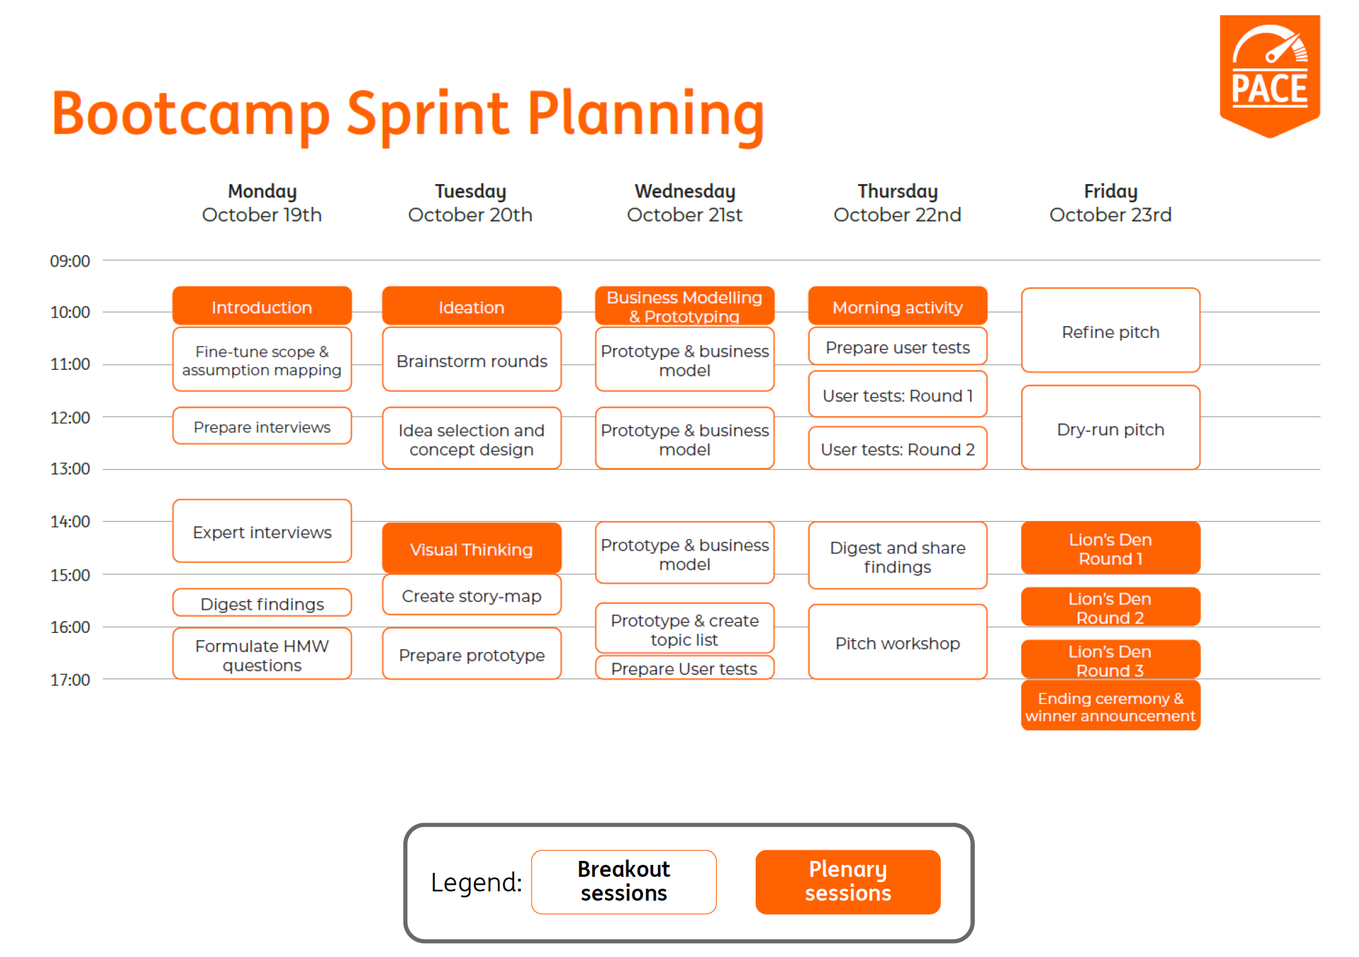
And we are only one sprint away from the grand finale

Slide 14
Estimated resources for a Smart Chat six-months MVP
Squad capacity:
1 Full stack developer
1 Front end developer
2 back end developers
1 Dev ops - Part time
PO/Scrum master
Once this MVP service is done we can go adding the rest of functionalities:
Automatic responses at the time of falls
Bi-directional file sending
Automatic responses by content
Contents catalogue
Catalog of previous answers
Integration with validations and authorizations
AI
Others ordered by the customers or the product itself
Could we get customers to help each other?
Notes:
Aportación:
- He aprendido del proceso y la metodologia en si, buenas formas de plantear ya no solo innovacion, si no que se pueden aplicar a muchos otros de ux o planteamiento de un proyecto desde tecnologia.
- Con todo lo que he descubierto y toda la gente he hablado, conozco mucho mejor el banco. He dado la lata a mucha gente, pero en especial:

Slide 15
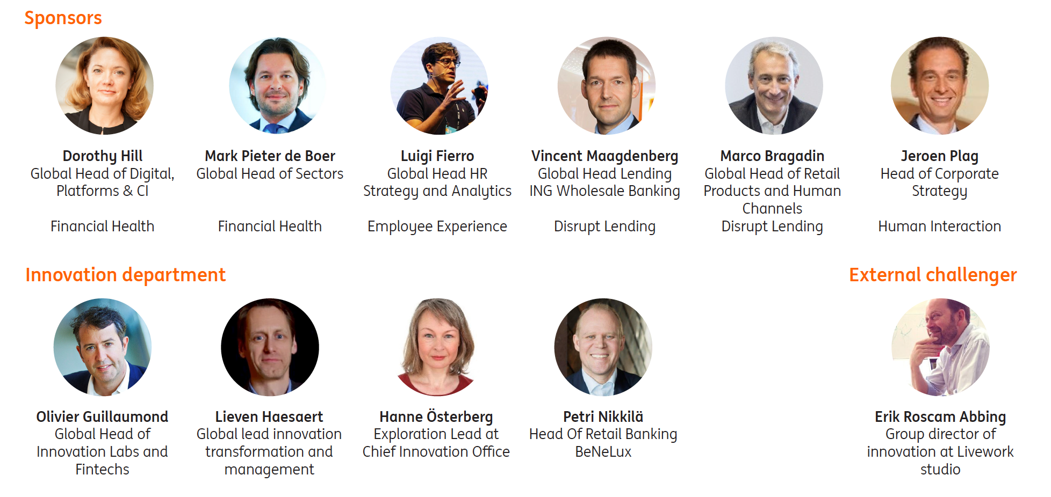
Innovation Bootcamp Grand Finale Jury Members
Notes:
Aportación:
- He aprendido del proceso y la metodologia en si, buenas formas de plantear ya no solo innovacion, si no que se pueden aplicar a muchos otros de ux o planteamiento de un proyecto desde tecnologia.
- Con todo lo que he descubierto y toda la gente he hablado, conozco mucho mejor el banco. He dado la lata a mucha gente, pero en especial:

Slide 16
Final Innovation Bootcamp – Innovation Summit

Slide 17
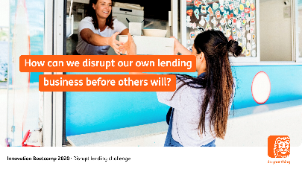
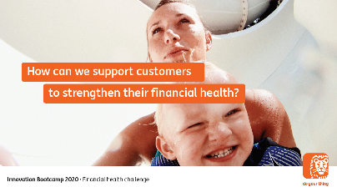
Two challenges in innovation value spaces…
Disrupt lending
How can we disrupt our lending business before others will?
Loans are an important financing instrument for clients. Without them, people and businesses would not be able to finance a renovation, manage cashflow issues, or keep a healthy company afloat in difficult times. Lending is also a major source of revenue for ING. But this income and our client relationships are under growing pressure.
Financial health
How can we support customers to strengthen their financial health?
If you can’t sleep at night, there’s a good chance it’s because you’re worried about money. Financial stress affects all of our customers, from private individuals to large businesses. Financial health is about more than having a positive balance sheet and being able to absorb shocks. Ultimately it is about being in a financial position that enables people to achieve their goals in life and business.
17

Slide 18
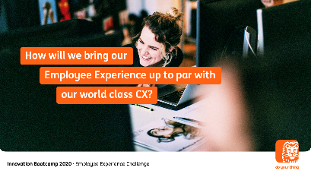
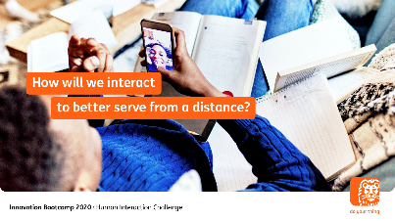
…and two challenges in improving the core
Employee Experience
How can we bring our employee experience up to par with our world class CX?
Employee experience is everything that an employee
sees, hears, thinks and feels when interacting with an
organisation. Think of it as Customer Experience (CX), but
then internally. To ensure EX is a differentiator at ING, we need
To understand and manage experiences that affect employee
engagement. We are starting to measure, redesign and fix
parts in the employee life cycle that are broken. Can you help us?
Human interaction
How will we interact to better serve from a distance?
Our interactions are a key component of being human. Whether
it is sharing experiences with loved ones, having everyday exchanges with colleagues, or solving problems with their bank. The Covid-19 outbreak has changed interactions with our customers. While needs have shifted from business-as-usual to survival, most contacts are now happening remotely. What can we learn from the crisis to serve or client better remotely?
18

Slide 19
The Innovation Bootcamp and the horizons model
All ideas for any horizon are welcome, however we are especially looking for:
+
+
H0
H1
H2
H3
Horizon 0
Maintain and enable the core
Horizon 1
Improve the core
Horizon 2
Expand the core
Horizon 3
New to the world
opportunities
Human interaction
How will we interact to better serve from a distance?
Employee Experience
How can we bring our employee experience up to par with our world class CX?
Disrupt Lending
How can we disrupt our lending business before others will?
Financial Health
How can we empower customers to strengthen their financial health in life and business?

Slide 20


The Innovation Bootcamp success story in short
During 5 Innovation Bootcamp editions, we reached more than 14,000 employees globally:
2014
2015
2016
2017
2018
4 challenges
774 ideas
~800 inventors
10 countries
4 challenges
1,806 ideas
~944 inventors
12 countries
4 challenges
1,194 ideas
~1,258 inventors
23 countries
2 challenges
786 ideas
~1,106 inventors
22 countries
3 challenges
349 ideas
~563 inventors
24 countries
109 Sprint applicants
Engagement PACE
ING Now
2nd place
ING Connect
Finalist
Marketplace Lending
People’s Choice award
and 3rd place
Spanish successes
Chameleon
Finalist

